Slide 1

planr
Landon Baxter
Josef Los
Michael Catchen
Darwin Boersma

Slide 2

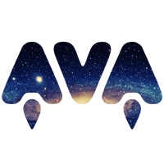




Notes:
Ava: Automated Testing
Node: JavaScript framework
Github: Social media website for farmers
Elephant = postgresql (Heroku/production db)
Trello: Project tracking
MySQL: Development db

Slide 3
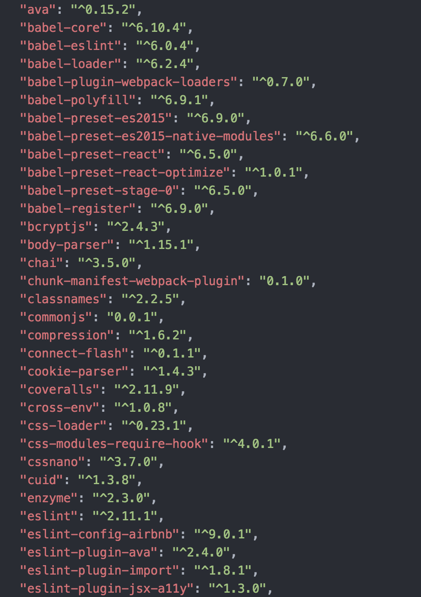
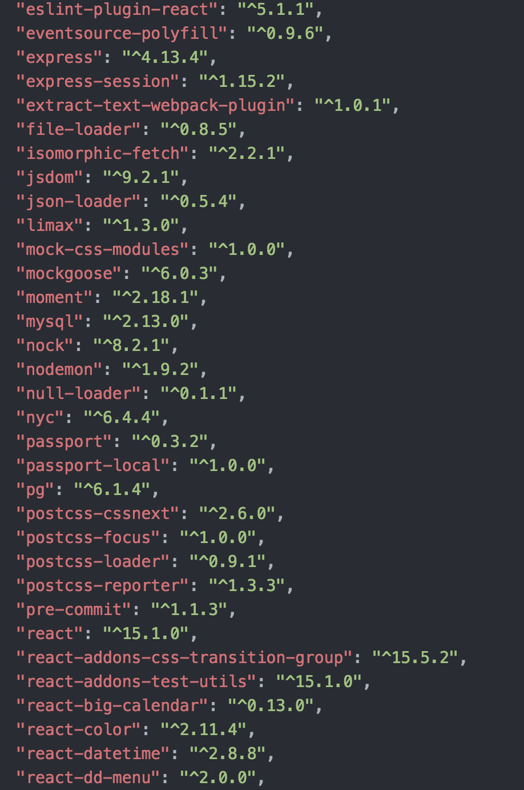
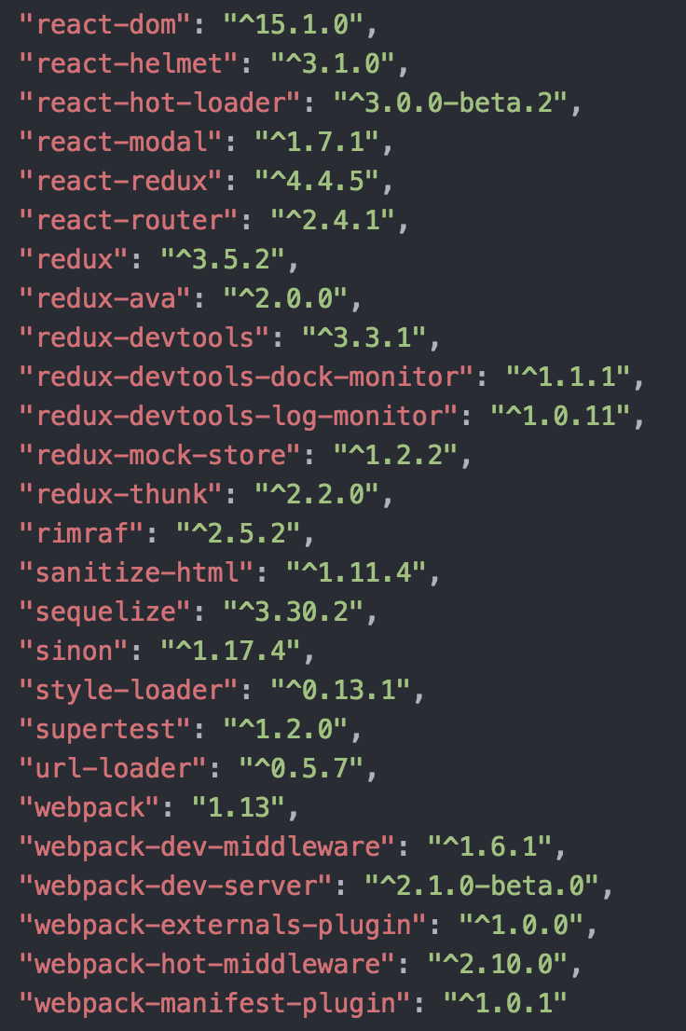
Notes:
Dependecies :^)

Slide 4
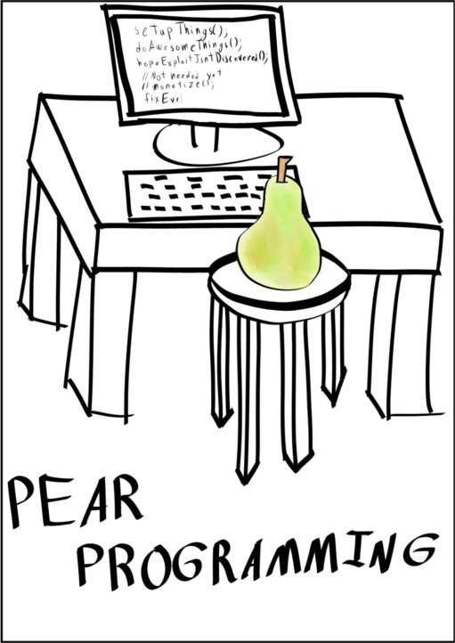
Notes:
We mostly took advantage of pair programming. No, not that pear.
Because 3 of us in the group were entirely new to JavaScript and the frameworks that we employed, we made sure to do a lot of “pair” programming. We often did this with 3 or 4 of us, so maybe pair isn’t the word. In any case, we often had one or two people typing while the others directed their coding.

Slide 5
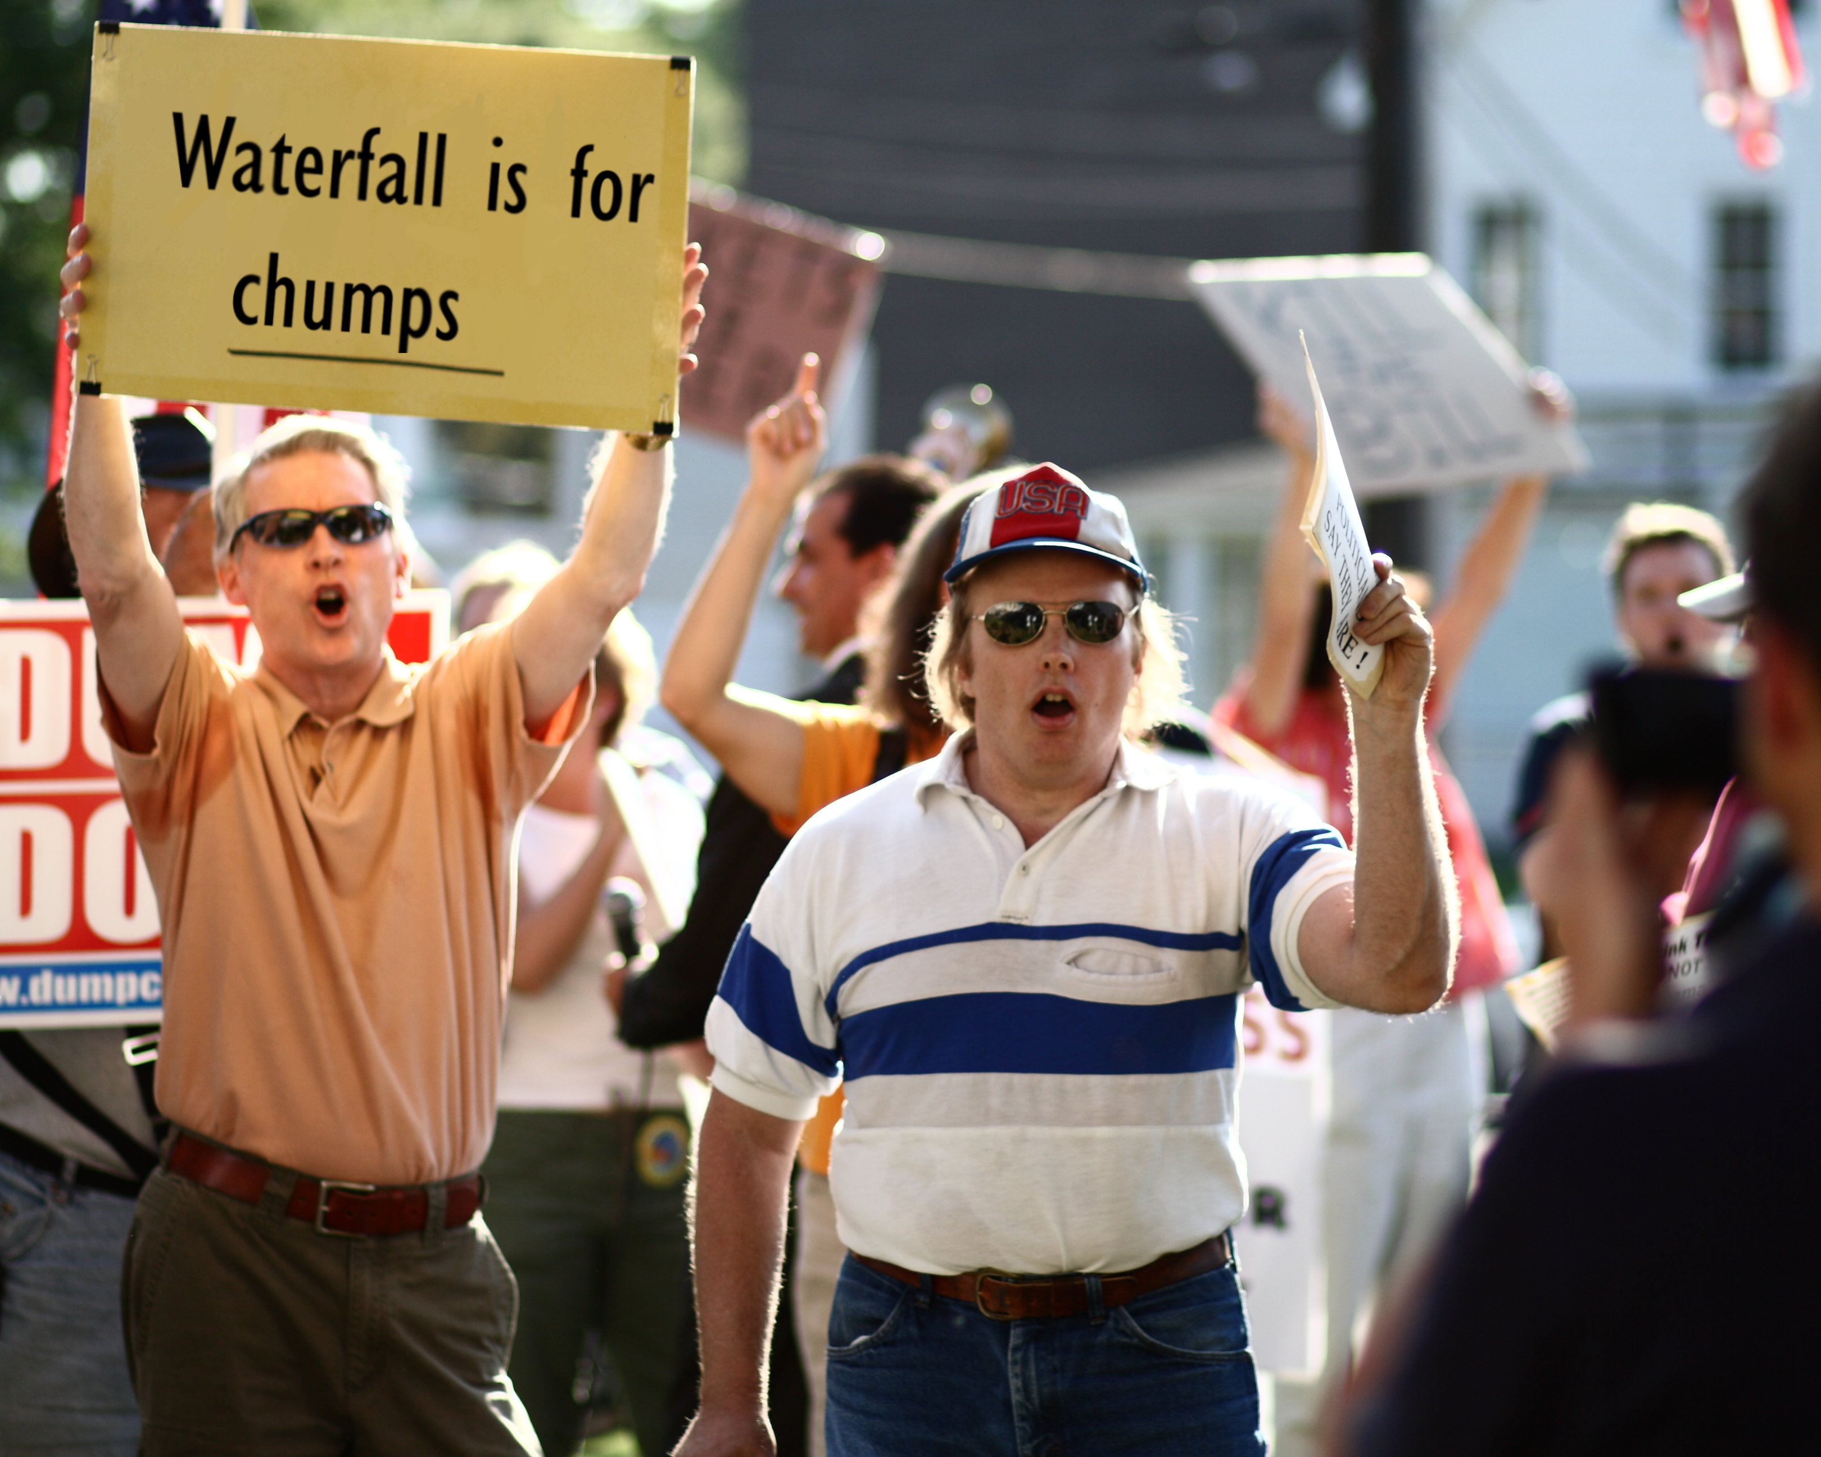
Notes:
We used primarily agile strategies. Throughout the project, we set small goals and had small sprints where we completed those goals. E.g., login, settings, etc. Along the way, we modified the scope of the project and designed different features rather than doing everything up front. Cause, you know, waterfall is for chumps.

Slide 6

Notes:
We touched on the challenges a bit earlier. The single biggest hurdle definitely had to be the learning curve, seeing that most of the group was unfamiliar with the language and the billion and one frameworks we had.
To overcome this, we began meeting twice a week every week and did pair programming. More often than not, Michael was helping the rest of us out because he knew what he was doing. Over time this allowed us to individually get work done. However, the difficulties did hinder our progress and made it unrealistic to implement all of our original plans. The core functionality is there, but the small plans we had originally fell a bit short.

Slide 7
Demo

